Slide 1


RPA industry Project use case study and Introduction UiPath Academy for professional certification Nanyang Polytechnic School of Information Technology

Slide 2
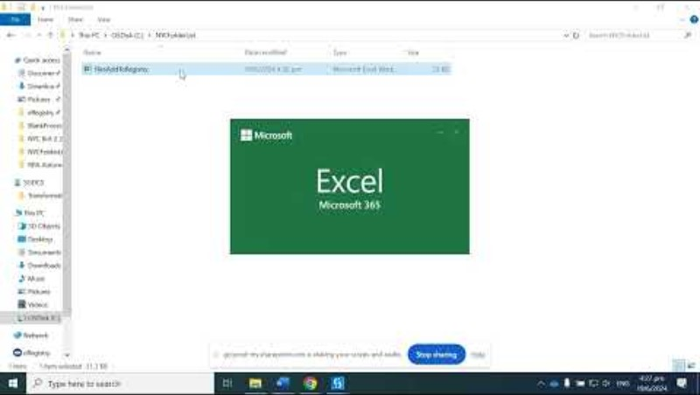
UiPath in action – NYC eRegistry bot 1and 2
Notes:
https://youtu.be/LuPi432b-cQ

Slide 3
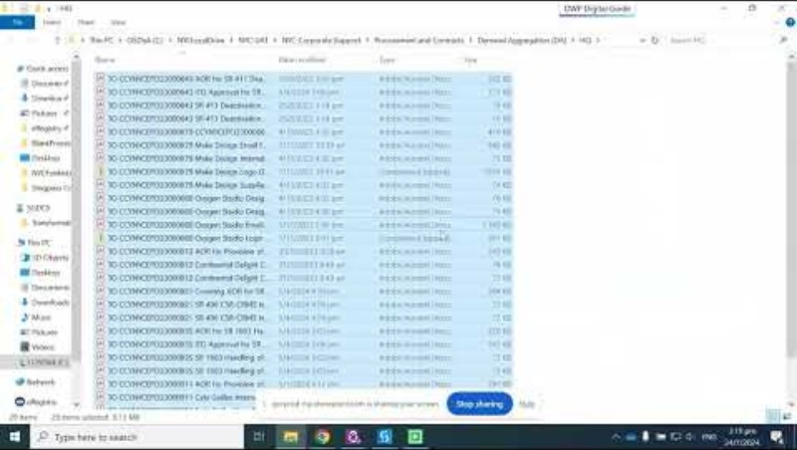
UiPath in action – NYC eRegistry bot 3 Use of Computer Vision, TryCatch, dataTable
Notes:
https://youtu.be/LuPi432b-cQ

Slide 4

UiPath in action – NYC eRegistry bot 1 to 3 Going onto Production in UiPath Assistant

Slide 5
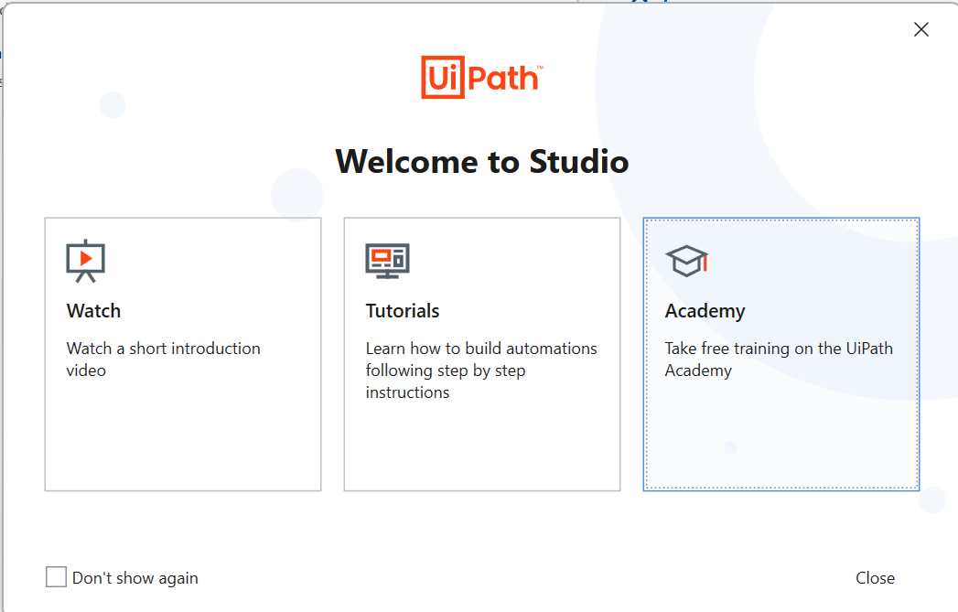
How to get UiPath Cert via the Acedemy

Slide 6
